Slide 1
Evaluation of 2 Broadly Neutralizing Antibodies Plus Vesatolimod in Early-Treated South African Women With HIV-1 During Analytical Treatment Interruption
Presentation 105
Krista Dong¹, Villeshni Asari², Vaneshree Govender³, Vanessa Pillay⁴, Siphesihle Ngcobo⁴, Nasreen Ismail⁵, Lucio Gama⁶, Elena Vendrame⁷, Megha Mehrotra⁷, Xiang Liu⁷, Lisa Selzer⁷, Mary Wire⁷, Devi SenGupta⁷, Thumbi Ndung’u⁸
¹Harvard Medical School, Cambridge, MA, USA; Massachusetts General Hospital, Boston, MA, USA; Ragon Institute of Mass General, MIT, and Harvard University, Cambridge, MA, USA; ²South African Medical Research Council (SAMRC), Durban, South Africa; ³The Aurum Institute NPC, Johannesburg, South Africa; ⁴Females Rising through Education, Support, and Health (FRESH), Durban, South Africa; ⁵University of KwaZulu-Natal, Durban, South Africa; ⁶Fundação Butantan, São Paulo, Brazil; ⁷Gilead Sciences, Inc., Foster City, CA, USA; ⁸HIV Pathogenesis Programme, The Doris Duke Medical Research Institute, University of KwaZulu-Natal, Durban, South Africa; Africa Health Research Institute, Durban, South Africa; Ragon Institute of Mass General, MIT, and Harvard University, Cambridge, MA, USA; Division of Infection and Immunity, University College London, London, UK
Conference on Retroviruses and Opportunistic Infections (CROI) 2025; March 9-12; San Francisco, CA, USA

Slide 2
Disclosures
Thumbi Ndung’u has received research grant funding and honoraria from Gilead Sciences, Inc.
2

Slide 3
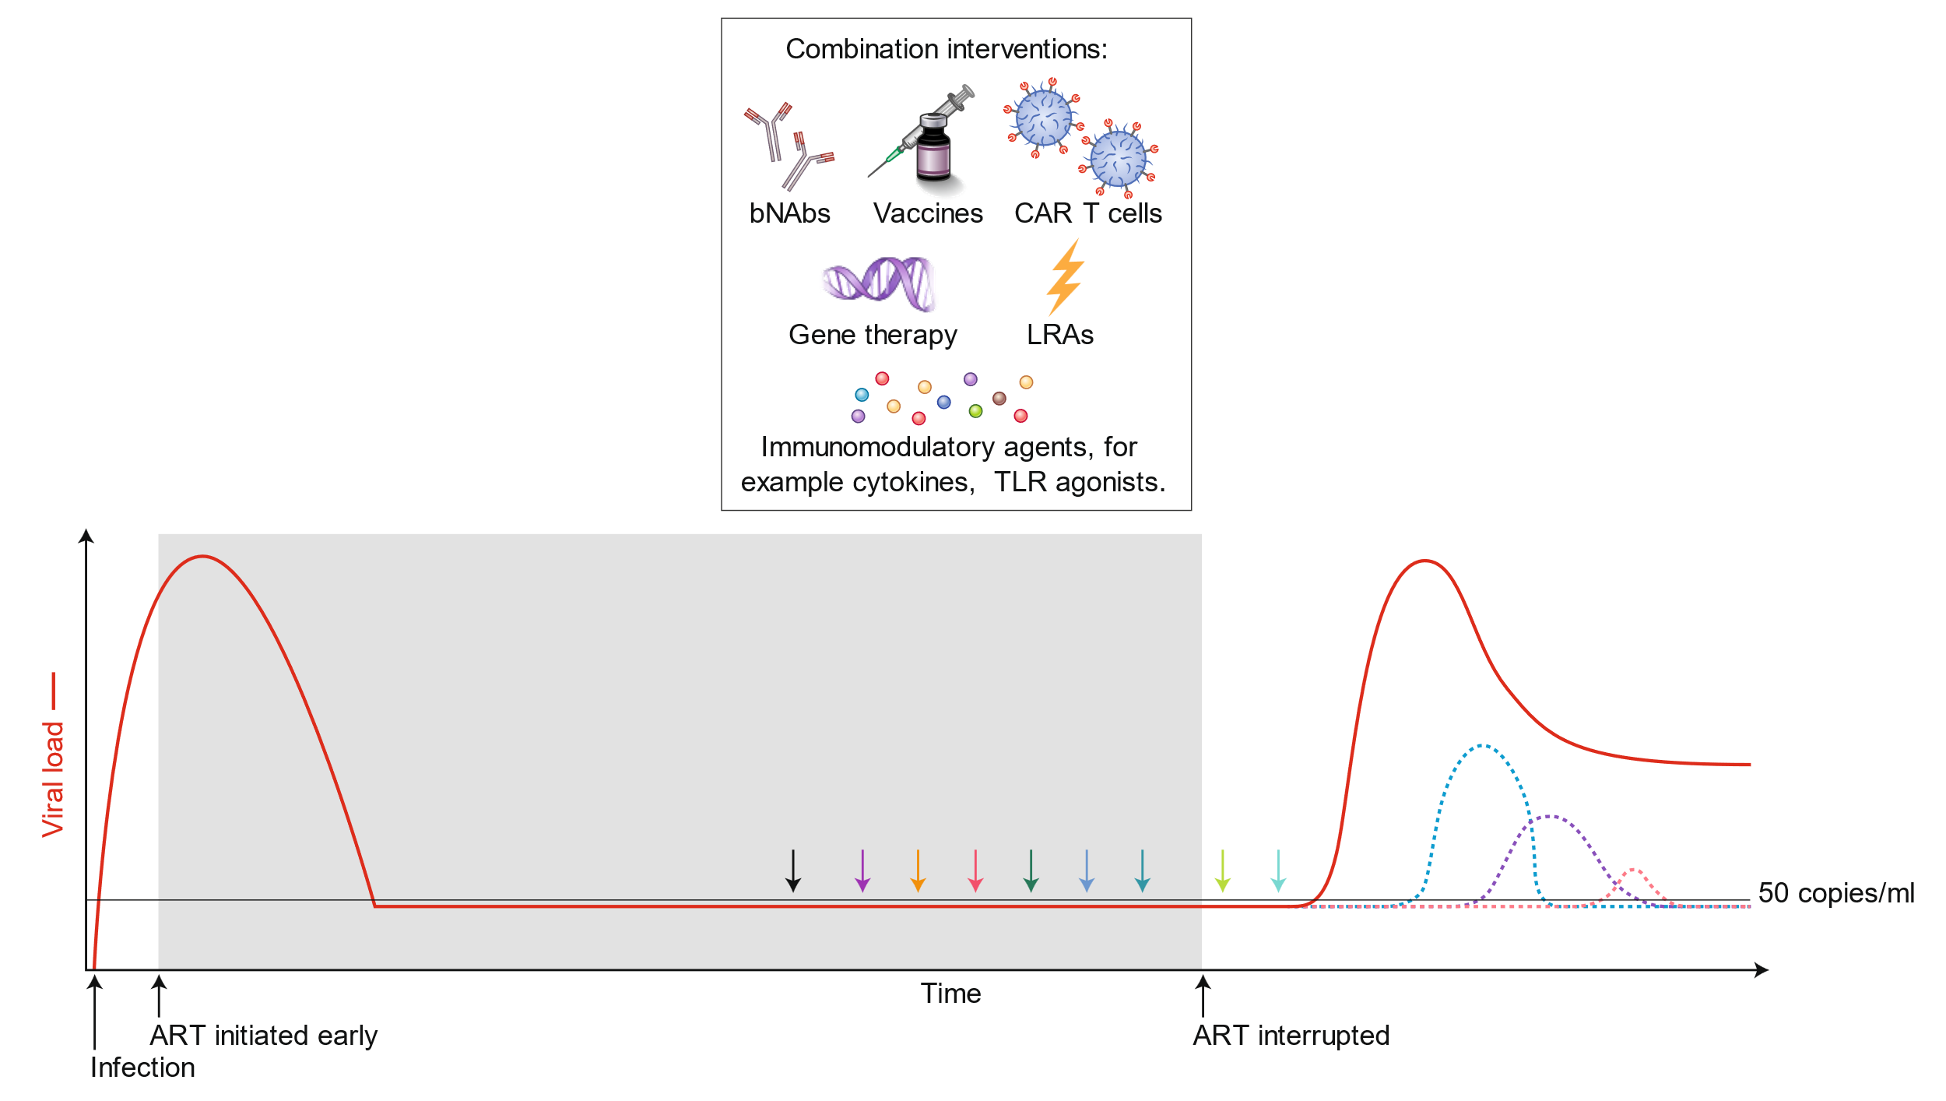
Considerations for HIV Cure or Remission Trials
Impact of early ART:
Reduced inflammation and immune activation
Limited viral diversification
Preserved functional immune responses
Lower reservoir burden and complexity
Monitoring during ATI:
Viral load (HIV RNA) every 2 weeks
Immune responses, reservoir size and composition
Clinical findings
Goal: Significantly delay viral rebound or lower the viral set point

Slide 4
GS-US-382-5445: The First HIV Cure Trial in Africa Enrolled Hyperacutely Treated South African Women From the FRESH Cohort
FRESH cohort designed to detect hyperacute HIV infection
Longitudinal follow up of high-risk women
(twice-weekly HIV testing)
Viral load with ART initiation during chronic infection
Viral load with early ART initiation
HIV infection
Participants in the trial began treatment at first detection of HIV

Slide 5
Single-Arm, Open-Label, Phase 2a Study
Inclusion criteria
Females from FRESH cohort
Virally suppressed on ART > 12 months
Sensitive to at least 1 of the 2 bNAbs
CD4+ T-cell count ≥ 500 cells/μL
ART stop
Week
≤ 35 days
0
2
4
6
8
10
12
14
16
18
20
21
40
48
49
60
6
Screening
Objective: Evaluate the safety, tolerability, and efficacy of VRC07-523LS + CAP256V2LS (bNAbs) and vesatolimod (VES; TLR7 agonist) during ATI
Results from a concurrent sociobehavioral study exploring site staff and participant experiences in the trial are expected in 2025. (PIs: Krista Dong and Karine Dubé)

Slide 6
Single-Arm, Open-Label, Phase 2a Study
Inclusion criteria
Females from FRESH cohort
Virally suppressed on ART > 12 months
Sensitive to at least 1 of the 2 bNAbs
CD4+ T-cell count ≥ 500 cells/μL
ART stop
Week
≤ 35 days
0
2
4
6
8
10
12
14
16
18
20
21
40
48
49
60
6
Screening
VES
ATI + VES/bNAb
ATI
Optional ATI
Period 1
Period 2
Period 3
Period 4
VES (oral)
Possible VES dose escalationª from 6 to 8 mg

Slide 7
Single-Arm, Open-Label, Phase 2a Study
Inclusion criteria
Females from FRESH cohort
Virally suppressed on ART > 12 months
Sensitive to at least 1 of the 2 bNAbs
CD4+ T-cell count ≥ 500 cells/μL
ART stop
Week
≤ 35 days
0
2
4
6
8
10
12
14
16
18
20
21
40
48
49
60
6
Screening
VES
ATI + VES/bNAb
ATI
Optional ATI
bNAbs
Period 1
Period 2
Period 3
Period 4
VES (oral)
Possible VES dose escalationª from 6 to 8 mg
bNAbs: VRC07-523LS + CAP256V2LS (NIH) (20 mg/kg IV each bNAb)

Slide 8
Single-Arm, Open-Label, Phase 2a Study
Inclusion criteria
Females from FRESH cohort
Virally suppressed on ART > 12 months
Sensitive to at least 1 of the 2 bNAbs
CD4+ T-cell count ≥ 500 cells/μL
ART stop
Week
≤ 35 days
0
2
4
6
8
10
12
14
16
18
20
21
40
48
49
60
6
Screening
VES
ATI + VES/bNAb
ATI
Optional ATI
bNAbs
Period 1
Period 2
Period 3
Period 4
VES (oral)
Possible VES dose escalationª from 6 to 8 mg
bNAbs: VRC07-523LS + CAP256V2LS (NIH) (20 mg/kg IV each bNAb)
Primary end point
Safety
Proportion of participants with treatment-emergent AEs
Secondary end points
Efficacy
Time to viral rebound (confirmed ≥ 50 copies/mL and ≥ 200 copies/mL)
Viral load at end of ATI
Time to ART resumption after ATI
Proportion of participants who restarted ART at 48 weeks
Pharmacokinetics
Serum PK and ADA for bNAbs

Slide 9
Single-Arm, Open-Label, Phase 2a Study
Inclusion criteria
Females from FRESH cohort
Virally suppressed on ART > 12 months
Sensitive to at least 1 of the 2 bNAbs
CD4+ T-cell count ≥ 500 cells/μL
ART stop
Week
≤ 35 days
0
2
4
6
8
10
12
14
16
18
20
21
40
48
49
60
6
Screening
VES
ATI + VES/bNAb
ATI
Optional ATI
bNAbs
Period 1
Period 2
Period 3
Period 4
VES (oral)
Possible VES dose escalationª from 6 to 8 mg
bNAbs: VRC07-523LS + CAP256V2LS (NIH) (20 mg/kg IV each bNAb)
ART restart criteria
Plasma HIV-1 RNA measurements ≥ 1000 copies/mL for 8 consecutive weeks without a drop of 0.3 log₁₀ from previous week
Confirmed plasma HIV-1 RNA > 100,000 copies/mL
Confirmed CD4+ T-cell count < 350 cells/μL
Pregnancy, participant request, or investigator/sponsor discretion due to other clinical criteria
During ATI, viral load was monitored every 2 weeks until initial rebound, then every week

Slide 10
Baseline Characteristics
Characteristic | Enrolled Participants (N = 20)
CD4+ count at screening, cells/µL, median (range) | 880 (520-1472)
Time to ART initiation, median (range), days | 1 (0-3)
Time on ART before enrollment, median (range), years | 6.9 (1.7-8.5)
Peak HIV-1 RNA before ART start, copies/mL, n (%)
≥ 50 to < 2000 | 9 (45)
≥ 2000 to ≤ 5000 | 4 (20)
> 5000 | 7 (35)
Fiebig stage at ART initiation, n (%)
I (HIV RNA+) | 17 (85)
II (HIV RNA+ and p24+) | 0
III (Ab+/WB-) | 3 (15)
IV (Ab+/WB+/p31-) | 0
Baseline bNAb susceptibility, n (%)
Susceptible to both bNAbs | 11 (55)
Susceptible to VRC07-523LS only | 7 (35)
Susceptible to CAP256V2LS only | 2 (10)
Minimal HIV exposure before starting ART and median time on treatment of almost 7 years

Slide 11
Safety Summary
No. (%) of Participants | VES + VRC + CAP (N = 20)
TEAE | 19 (95)
Study drug–related | 18 (90)
TEAE grade 2 or higher | 14 (70)
Study drug–related | 8 (40)
TEAE grade 3 or higher | 4 (20)
Study drug–related | 2 (10)
SAE | 2 (10)
Study drug–related | 0
TEAE leading to premature discontinuation of study drug | 1 (5)
Grade 1 cytokine release syndrome considered related to VES | 1 (5)
TEAE leading to death | 0
Overall, the study regimen was well tolerated;
Infusion related reactions were frequent (n=18, 90%), but mostly mild in severity

Slide 12
bNAb Concentrations
Single-dose VRC07-523LS and CAP256V2LS each administered as 20 mg/kg IV at week 1
Mean (SD) VRC07-523LS Concentration–Time Plot
Mean (SD) CAP256V2LS Concentration–Time Plot
Period 1
Period 2
Period 3
Period 1
Period 2
Period 3
1000
ATI
1000
ATI
100
100
VRC07-523LS Concentration (µg/mL)
CAP256V2LS Concentration (µg/mL)
10
10
100× median baseline IC₅₀ = 9 ug/mL
1
1
0.1
0.1
100× median baseline IC₅₀ = 0.32 ug/mL
0
4
8
12
16
20
24
28
32
36
40
0
4
8
12
16
20
24
28
32
36
40
ART stopped
Study Week
ART stopped
Study Week
Period 1: bNAb + VES
Period 2: VES + ATI
Period 3: ATI
As expected, mean bNAb concentrations remained above therapeutic levels through the end of Period 2

Slide 13
Three Distinct ATI Outcome Patterns
Period 2ª
VES + ATI
Period 3
ATI
Period 4
Optional
ATI Extension
Group 1: Early ART Restart
7/20 (35%) participants restarted ART during Period 2
100,000
1000
16
Weeks of ATI
44
56
100,000
HIV-1 RNA Copies/mL
1000
16
Weeks of ATI
44
56
100,000
1000
16
Weeks of ATI
44
56
ªbNAb concentrations remained above therapeutic levels for all participants throughout Period 2.
ART, antiretroviral therapy; ATI, analytical treatment interruption; VES, vesatolimod.

Slide 14
Three Distinct ATI Outcome Patterns
Period 2ª
VES + ATI
Period 3
ATI
Period 4
Optional
ATI Extension
100,000
1000
Group 2: Delayed ART Restart
7/20 (35%) participants restarted ART during Period 3
100,000
HIV-1 RNA Copies/mL
1000
16
Weeks of ATI
44
56
100,000
1000
16
Weeks of ATI
44
56
ªbNAb concentrations remained above therapeutic levels for all participants throughout Period 2.
ART, antiretroviral therapy; ATI, analytical treatment interruption; VES, vesatolimod.

Slide 15
Three Distinct ATI Outcome Patterns
Period 2ª
VES + ATI
Period 3
ATI
Period 4
Optional
ATI Extension
100,000
1000
Group 3: Late ART Restart and Post-treatment Controllers
6/20 (30%) remained off ART through week 48 (44 weeks of ATI)
4/20 (20%) remained off ART through the end of study (55 weeks of ATI)
Post-trial, the 4 controllers opted to remain off ART and in close follow-up
They are now off ART for a median of 1.5 years (range 1.2-2.4)
100,000
HIV-1 RNA Copies/mL
1000
100,000
1000
16
Weeks of ATI
44
56
ªbNAb concentrations remained above therapeutic levels for all participants throughout Period 2.
ART, antiretroviral therapy; ATI, analytical treatment interruption; VES, vesatolimod.

Slide 16
40% Had Oscillating Viral Rebound Dynamics
Typical Rebound Dynamics n = 12 (60%)
1,000,000
The median time to viral rebound (≥ 50 copies/mL) after ATI was 11 weeks (95% CI, 7-18)
12 (60%) participants exhibited typical viral rebound dynamics once rebound occurred
8 (40%) participants exhibited atypical dynamics, including oscillation (re-suppression after initial rebound) and nonexponential growth
10,000
100
HIV-1 RNA Copies/mL
Oscillating Viral Rebound Dynamics and Control n = 8 (40%)
1,000,000
10,000
100
0
10
20
30
40
Weeks Since First Detectable HIV RNA
ATI, analytical treatment interruption.

Slide 17
Conclusions
This first-in-Africa HIV cure trial demonstrates that complex cure studies can be successfully conducted in resource-limited settings with great unmet need via partnership with community and multisector collaborators
The treatment regimen of VES, VRC07-523LS, and CAP256V2LS was well tolerated, with no serious study drug-related TEAEs reported
20% of participants achieved durable ART-free viral control and 40% experienced atypical rebound dynamics
While this regimen did not achieve durable control in all participants, ongoing analyses will inform the development of future cure approaches
Insights from an integrated sociobehavioral study will be critical for shaping the design and implementation of future HIV cure trials in diverse settings
17

Slide 18
Acknowledgements
We extend our thanks to the trial participants, their partners and family members, the study team at FRESH, HIV Pathogenesis Programme (HPP) core lab staff, counselors from University of KwaZulu-Natal (UKZN), HPP Community Advisory Board, and University Pathology Lab
The NIH Vaccine Research Center contributed extensive knowledge on bNAb development, supplied the bNAbs and performed pharmacokinetic testing
This study was funded by Gilead Sciences, Inc.
Editing and production assistance were provided by Parexel, and funded by Gilead Sciences, Inc.
Correspondence: Megha Mehrotra, megha.mehrotra@gilead.com
18

